Slide 1

Optimizing HealthFirst Care Workflows for Efficiency & Patient Satisfaction

Slide 2
Table of Contents
Executive Summary
Introduction
Business Objectives
Problem & Key Needs
Constraints & Acceptance Criteria
Key Functional Requirements
Stakeholder Overview
Stakeholder Engagement and Communication
Project Scope
Scope Management
Scope Change Management
Workflows
Swimlanes
Dashboard Overview
SQL Analysis
Risk Management
Risk Mitigation
Findings & Recommendations
Summary
Acknowledgements & Credits

Slide 3
Executive Summary
Problem:
Manual scheduling and communication inefficiencies cause long patient wait times, double bookings, and operational delays.
Key insights:
Over 35% of appointments are rescheduled due to conflicts, highlighting scheduling system flaws.
Resource strain varies by department, with Oncology and Pediatrics under-resourced and General Medicine overutilized.
Recommended actions:
Implement an automated appointment scheduling system with conflict detection and real-time notifications.
Introduce self-service patient check-in options to reduce wait times and administrative workload.
Deploy a centralized communication platform to improve interdepartmental coordination and issue resolution.

Slide 4
Introduction
Opportunity:
Improve patient experience by reducing wait times and scheduling conflicts.
Enhance hospital efficiency through better resource management and communication.
Approach:
Implement automated scheduling, real-time notifications, and integrated Hospital Information System (HIS).
Introduce self-service check-in and centralized communication tools for streamlined workflows.
Key questions/hypotheses:
Will automation and real-time updates significantly reduce wait times and no-shows?
Can improved resource visibility and communication decrease staff workload and operational delays?

Slide 5

Business Objectives
Reduce patient wait times for appointments and services.
Increase efficiency and accuracy of appointment scheduling.
Enhance real-time communication between hospital departments and with patients.
Improve visibility and allocation of medical staff and equipment resources.
Streamline patient check-in processes to minimize administrative bottlenecks.
Boost patient satisfaction through timely notifications and post-visit follow-ups.

Slide 6

Methodology

Slide 7

Requirements Gathering - Problem & Key Needs
Problem Statement
Long patient wait times due to manual scheduling and communication gaps
Scheduling conflicts causing double bookings and delays
Inefficient resource allocation and poor inter-department communication
Low patient satisfaction and staff overload
Key Requirements to Improve Efficiency
Automated appointment scheduling with conflict detection & real-time updates
Centralized communication platform for seamless team coordination
Integration with Hospital Information System (HIS) for data access
Real-time visibility into doctor and resource availability
Automated patient notifications via email/SMS
User-friendly interfaces accessible for all patient groups

Slide 8
Requirements Gathering - Constraints & Acceptance Criteria
Constraints
Limited project budget capped at $500,000
Project timeline restricted to 6 months for completion
Integration challenges with existing legacy hospital systems
Mandatory compliance with HIPAA and hospital data security policies
System downtime limited to no more than 1 hour per month
Potential resistance to change among senior staff and users
Acceptance Criteria
Appointment scheduling system operates with <2 seconds response time
System uptime of 99.9% to ensure availability
Real-time notifications successfully delivered to patients and staff
Seamless data integration with Hospital Information System (HIS)
Positive user feedback on system usability, especially from elderly users
Demonstrated reduction in patient wait times and scheduling conflicts

Slide 9
Key Functional Requirements
Requirement ID | Requirement Description | Priority (MoSCoW) | Stakeholder(s) | Project Objective | Related Data File | Status
FR1 | Automate appointment scheduling with conflict detection | Must Have | Administrative Staff | Reduce wait times and scheduling errors | appointment_data.csv | Approved
FR2 | Implement real-time appointment notifications for patients | Must Have | Patients, Admin Staff | Improve patient satisfaction and reduce no-shows | feedback_data.csv | Approved
FR4 | Integrate HIS for seamless patient and resource data access | Must Have | IT Teams, Doctors, Admin Staff | Streamline operations and improve data access | resource_data.csv | Approved
FR5 | Allow admin staff real-time access to doctor availability | Must Have | Administrative Staff | Optimize scheduling and resource allocation | appointment_data.csv | Approved
FR7 | Enable patients to receive post-visit instructions via SMS/email | Could Have | Patients | Enhance patient engagement and communication | feedback_data.csv | Approved
FR9 | Notification system for lab results and inter-department messages | Must Have | Doctors, Nurses, Admin Staff | Reduce communication delays | feedback_data.csv | Approved
FR10 | Online appointment booking with real-time calendar sync | Must Have | Patients, Admin Staff | Improve scheduling efficiency and user experience | appointment_data.csv | Approved
FR11 | Real-time resource inventory dashboard | Must Have | IT Teams, Admin Staff | Provide visibility into resource availability | resource_data.csv | Approved
NFR5 | Simple UI/UX suitable for elderly users | Must Have | Patients | Ensure system accessibility for all user types | feedback_data.csv | Approved

Slide 10
Stakeholder Overview
Patients: Service recipients - need timely notifications & reduced wait times
Doctors & Nurses: Require real-time schedule visibility and resource updates
Administrative Staff: Manage scheduling & coordination
IT Teams: Implement and maintain HIS and security
Hospital Leadership: Oversee budget and compliance

Slide 11
Stakeholder Engagement & Communication
Engagement Strategies
Patients: Monthly surveys and newsletters
Doctors & Nurses: Weekly check-ins and dashboards
Admin Staff: Weekly coordination meetings
IT Teams: Bi-weekly technical updates
Leadership: Monthly strategic briefings
Support Staff: As-needed updates
Communication Strategies
Use email, SMS, dashboards, and meetings
Regular feedback via surveys and direct input
Role-based messaging tailored to each group

Slide 12
Project Scope
Constraints:
Project budget limited to $500,000.
Completion is required within 6 months.
Compliance with HIPAA and hospital data security policies.
Dependency on availability of hospital IT infrastructure.
Assumptions:
Stakeholders (doctors, nurses, admin staff) will be available for periodic reviews.
Appointment, feedback, and resource data are accurate and accessible.
Hospital leadership will provide timely decisions on scope changes.
In-Scope:
Development of a new integrated scheduling system
Implementation of a centralized communication platform across departments
Enhancement of patient communication via email/SMS
Upgrade of resource tracking and availability systems
Integration of a Hospital Information System (HIS)
Out-of-Scope:
Construction or redesign of physical infrastructure
Hiring of additional full-time medical staff
Overhaul of entire legacy systems beyond core modules

Slide 13
Scope Management Plan
WBS ID | Task Name | Task Description | Milestone
1.0 | Initiation | Define project goals, scope, and secure approvals | Project kickoff
2.0 | Planning | Develop detailed project plan and resource allocation | Project plan approved
3.0 | Design & Development | Build scheduling system and communication platform | Completion of system design
4.0 | Implementation | Deploy systems, integrate HIS, and migrate data | System go-live
5.0 | Testing & Validation | Conduct user acceptance testing and fix issues | UAT sign-off
6.0 | Training & Deployment | Train staff and roll out new processes | Staff trained
7.0 | Monitoring & Support | Provide ongoing support and monitor system performance

Slide 14
Scope Change Management
Document all change requests formally
Assess impact on budget, schedule, and resources
Get approval from stakeholders before implementation
Communicate changes to all teams promptly
Keep a log of all changes and decisions
Control process to prevent scope creep

Slide 15
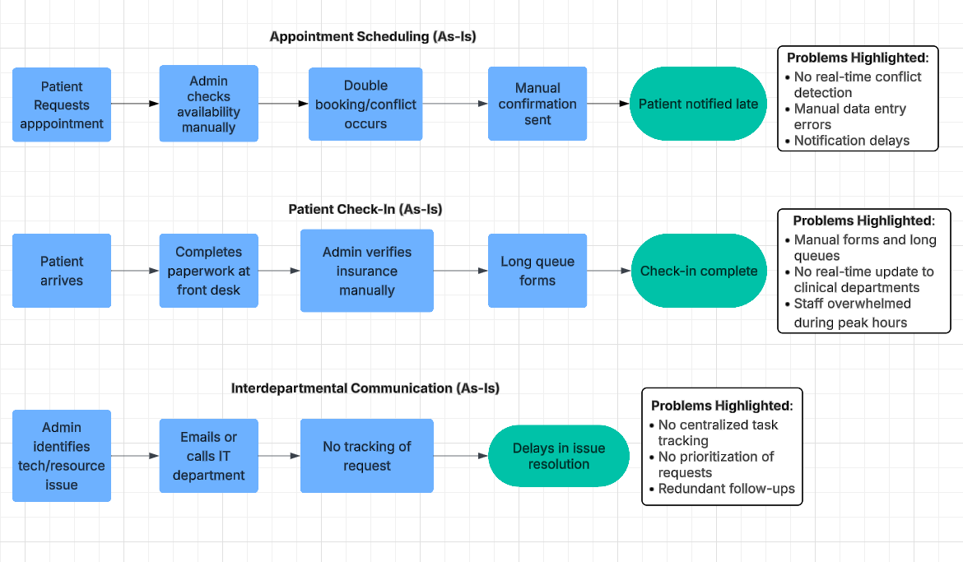
Current Workflows (As-Is)
Methodology:
Reviewed workflows for appointment scheduling, patient check-in, and interdepartmental communication.
Conducted staff interviews and process mapping.
Findings:
Appointment Scheduling: Manual entry = delays, double bookings, missed updates.
Patient Check-In: Manual paperwork & staff verification = long wait times, bottlenecks.
Communication: Lack of structured process between admin & IT = slow response times.
Implications:
Operational inefficiencies affect both staff productivity and patient satisfaction.

Slide 16
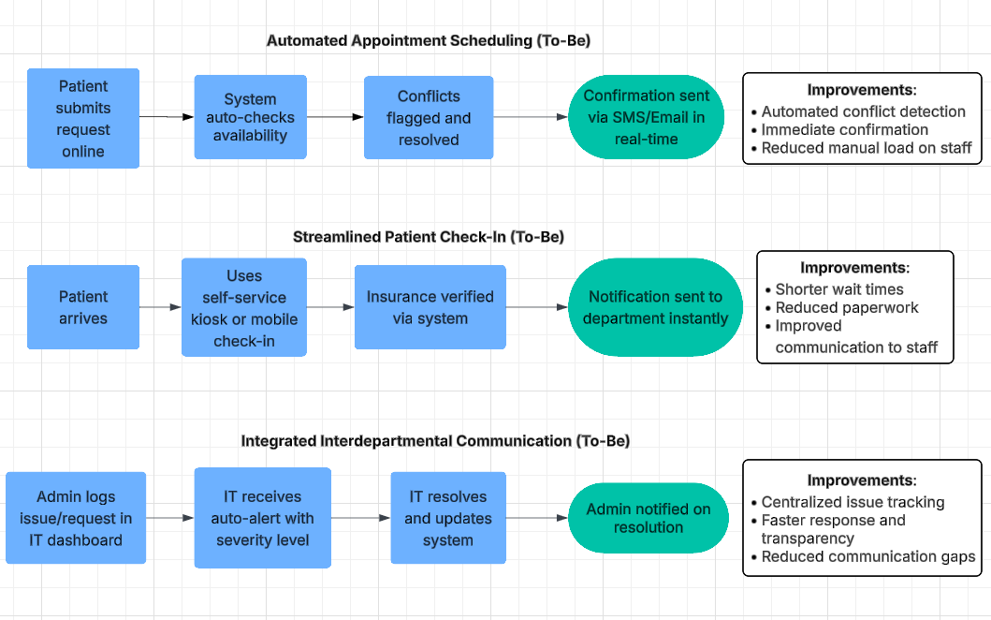
Optimized Processes (To-Be)
Methodology: Process redesign using workflow automation tools and coordination strategies.
Findings:
Automated Scheduling: Real-time conflict detection, email/SMS confirmations.
Self Check-In: Kiosks or online check-in to reduce paperwork and waiting times.
Centralized Task Management: Improved tracking and resolution of interdepartmental issues.
Implications: Reduced errors, faster service, better collaboration, improved patient experience.

Slide 17
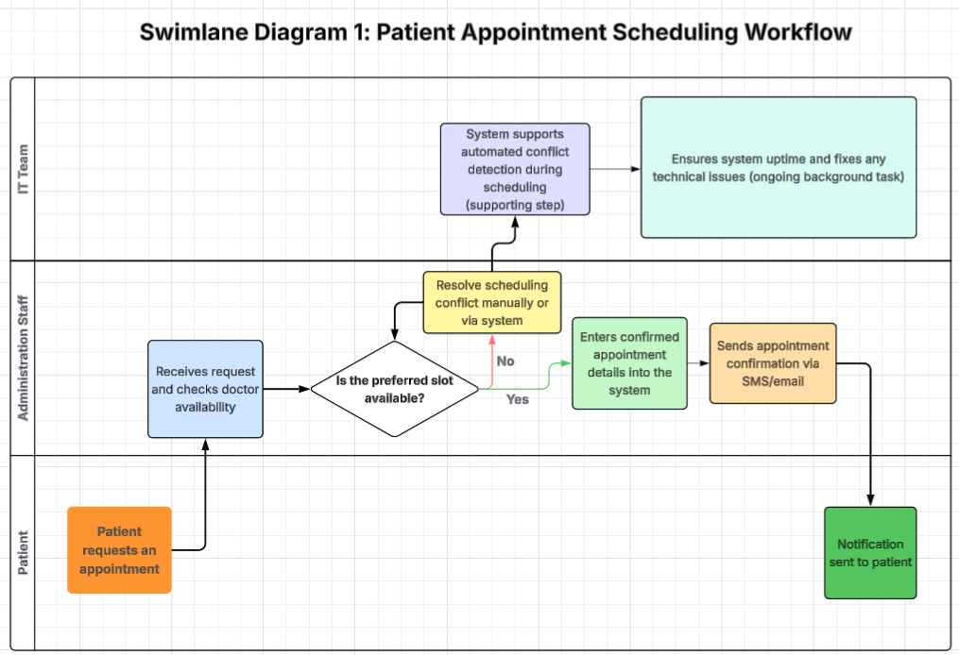

Slide 18
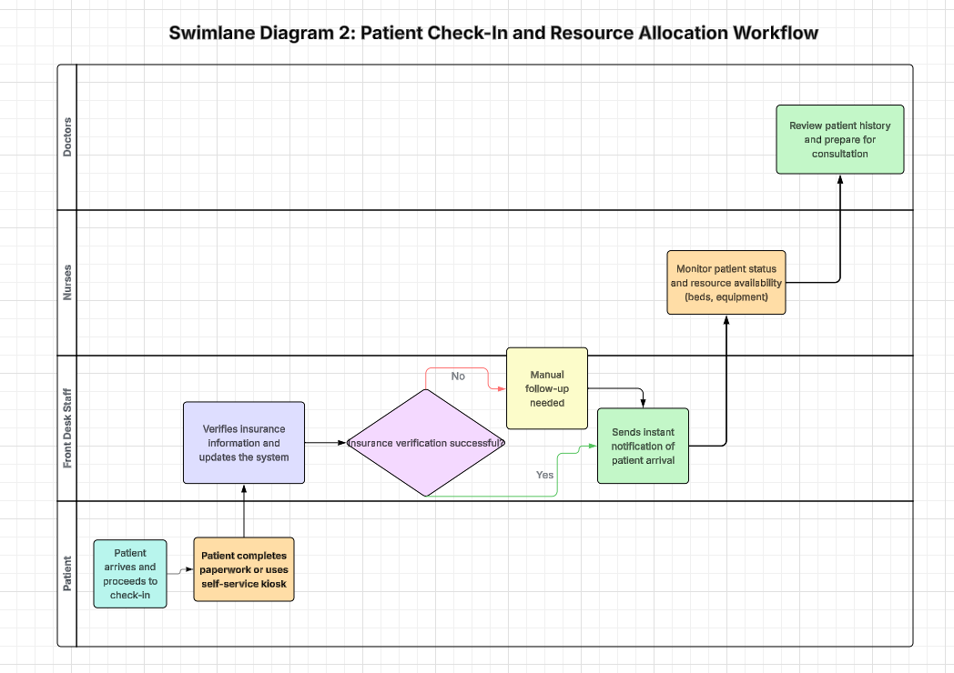

Slide 19
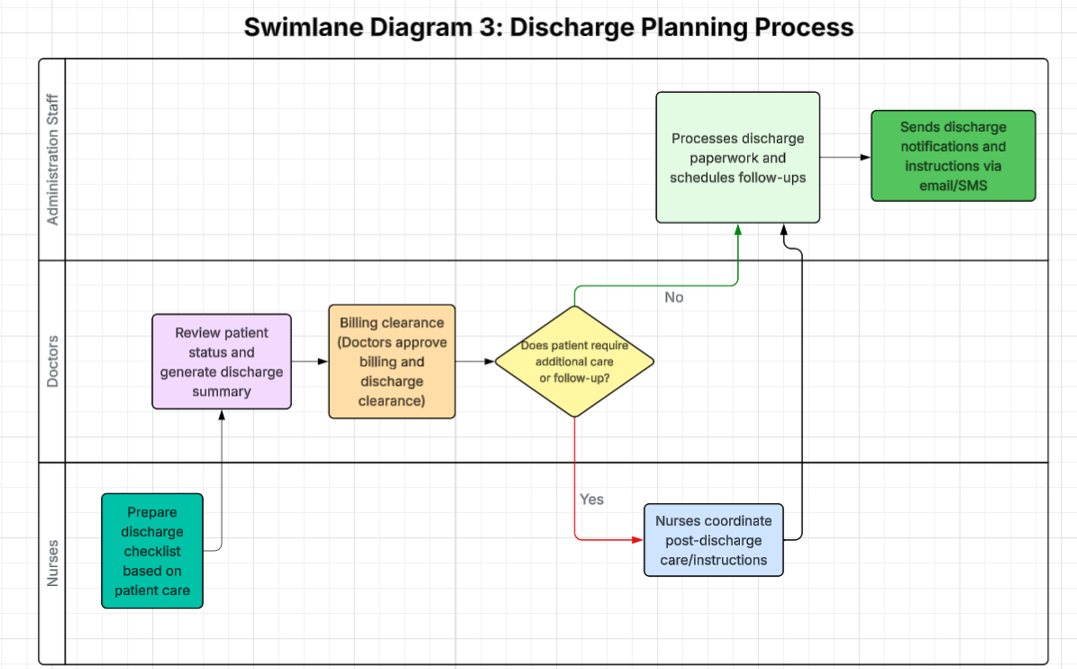

Slide 20
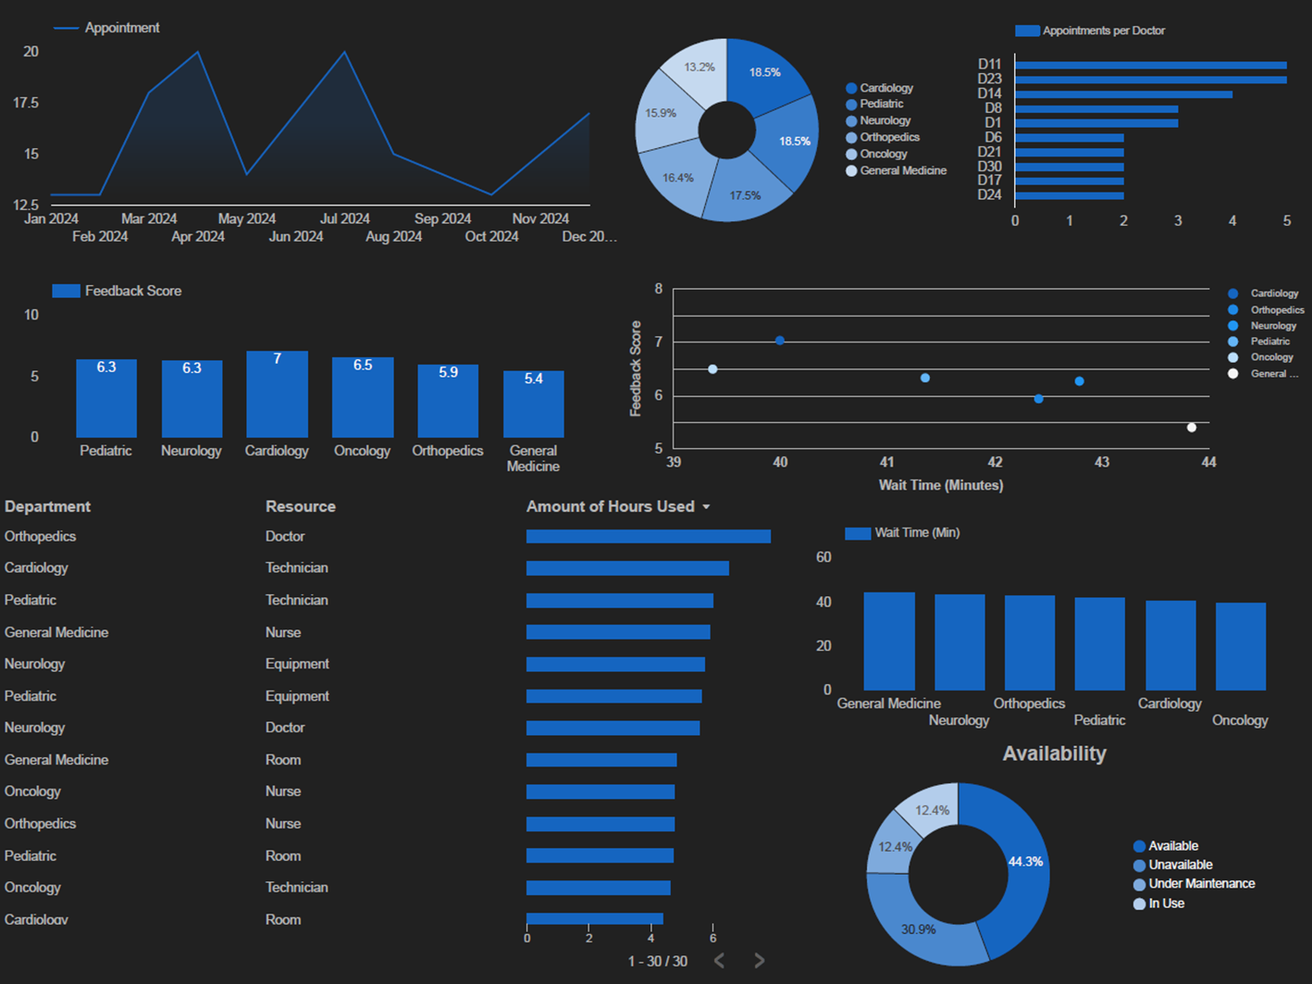
HealthFirst Care Dashboard
Tracks appointments, wait times, feedback scores, and resource utilization across departments.
Highlights workload distribution, operational bottlenecks, and correlations between wait times and satisfaction.
Supports real-time decision-making for scheduling, staffing, and resource allocation.

Slide 21
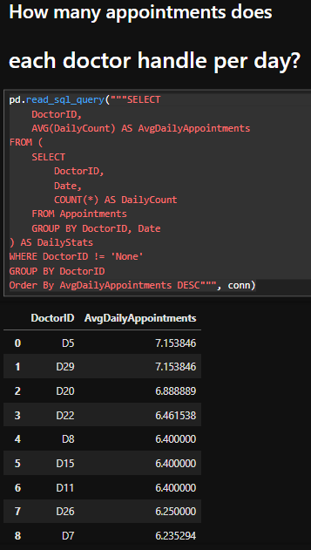
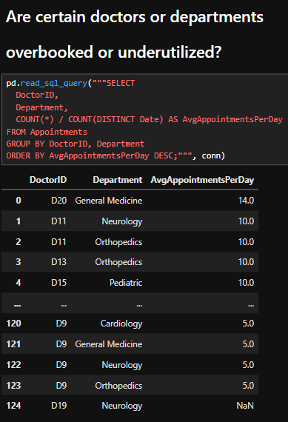
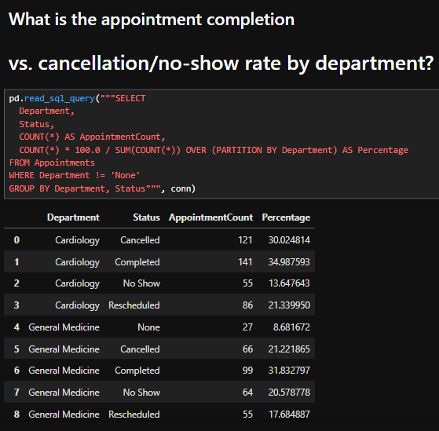
SQL Query Behind The Analysis

Slide 22
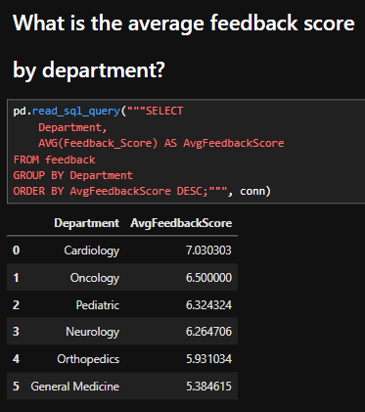
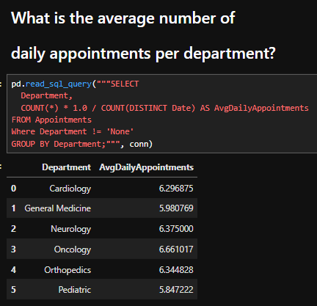
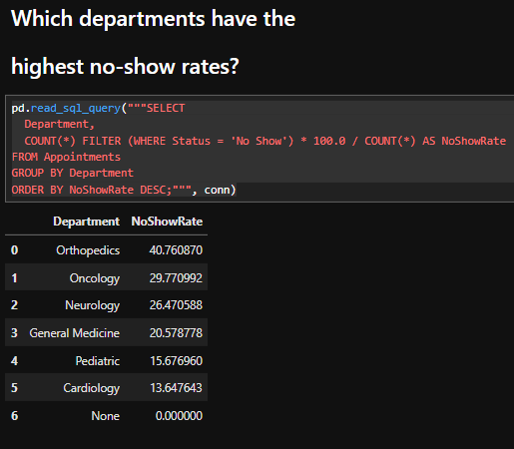
SQL Query Behind the Analysis

Slide 23
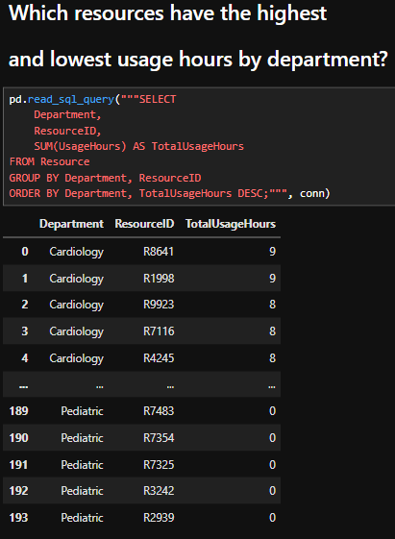
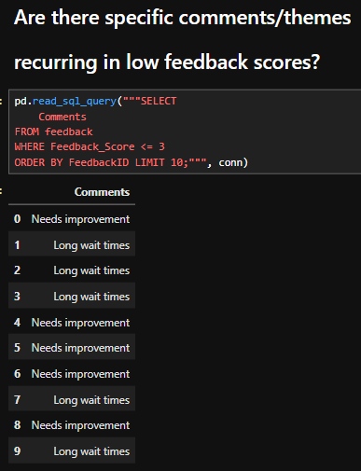
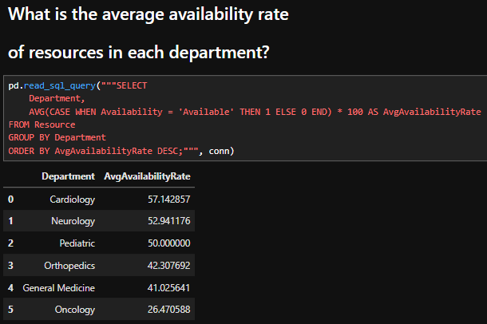
SQL Query Behind the Analysis

Slide 24
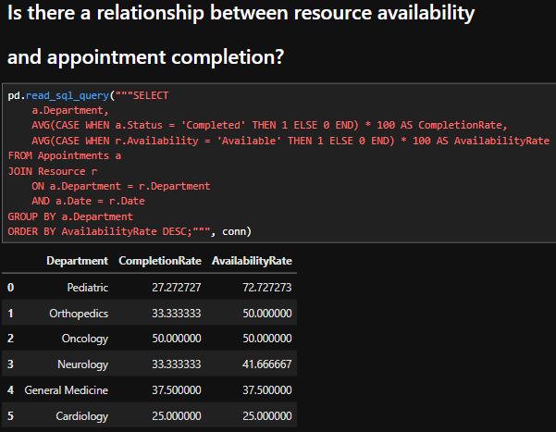
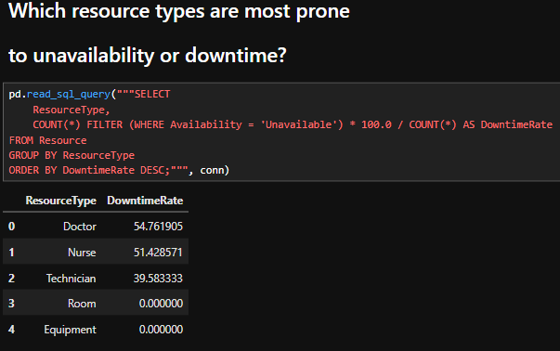
SQL Query Behind the Analysis

Slide 25
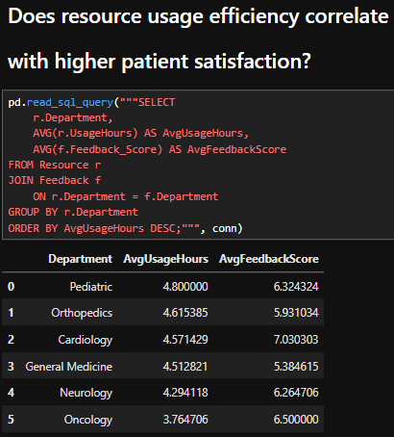
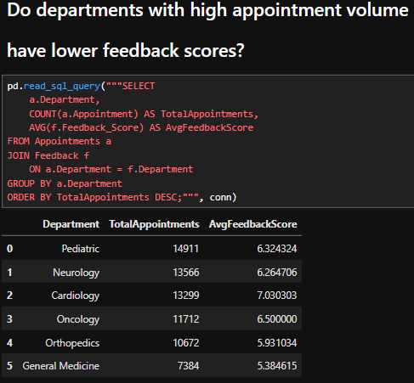
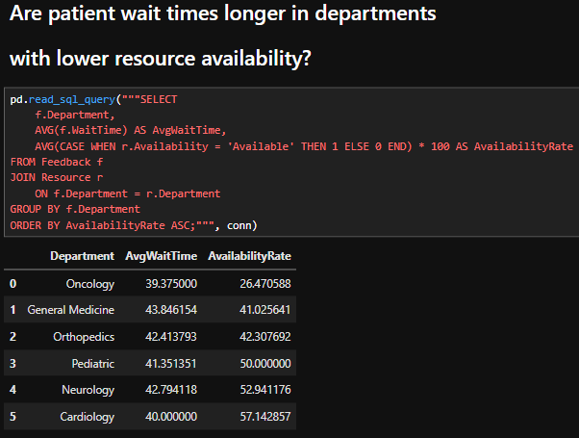
SQL Query Behind the Analysis

Slide 26
Risk Management Plan
Risk ID | Risk Description | Category | Likelihood | Impact | Severity | Mitigation Strategy
R1 | Integration issues with legacy systems | Technical | High | High | Critical | Conduct thorough compatibility testing and phased integration
R2 | Staff resistance to new system adoption | Organizational | Medium | High | High | Provide training and engage staff early in the process
R3 | Data breaches or HIPAA non-compliance | Security | Low | Critical | High | Implement strict security protocols and regular audits
R4 | Budget overruns due to unforeseen expenses | Financial | Medium | Medium | Medium | Maintain contingency funds and monitor costs closely
R5 | System downtime impacting hospital workflow | Operational | Low | High | High | Schedule maintenance during off-peak hours and have backups

Slide 27
SWOT Analysis for HealthFirst Care Initiative
Strengths | Weaknesses
Strong leadership commitment | Manual workflows causing inefficiencies
Reliable datasets (appointments, feedback) | Staff resistance to change
Clear business objectives & stakeholder engagement | Dependence on legacy systems
Cloud-based scalable infrastructure | Limited IT staff availability
Opportunities | Threats
Process automation & HIS integration | Risk of data breaches & HIPAA violations
Enhanced staff training and engagement | Change resistance from senior staff
Better patient engagement via SMS/email | Budget & time constraints
Centralized issue tracking & communication | Integration delays with legacy tech

Slide 28
Risk Management Plan Key Insights
Integration with legacy systems poses a significant risk to timelines and costs.
Change resistance from staff could delay adoption and reduce effectiveness.
Data security and HIPAA compliance require ongoing vigilance and controls.
Limited budget and tight schedule increase pressure on resource allocation.
Potential downtime must be minimized to avoid disrupting hospital operations.
Proactive communication and training are critical to mitigate user resistance.

Slide 29
Risk Mitigation Plan
Risk ID | Description | Likelihood | Impact | Severity | Mitigation Strategy | Contingency Plan
R1 | Integration issues with legacy systems | High | High | Critical | Phased testing and gradual rollout | Revert to legacy system if critical failures
R2 | Staff resistance to new system | Medium | High | High | Training and change management | Provide additional support and coaching
R3 | Data breaches or HIPAA non-compliance | Low | Critical | High | Strict security policies and regular audits | Incident response plan and data recovery
R4 | Budget overruns | Medium | Medium | Medium | Monitor expenses and maintain contingency funds | Scale back non-critical features
R5 | System downtime | Low | High | High | Schedule maintenance during off-hours, backups | Use backup systems and emergency protocols

Slide 30
Key Insights - Risk Mitigation Plan
Prioritize and address the highest-impact risks early.
Combine mitigation and contingency plans for resilience.
Training and communication reduce resistance risks.
Continuous monitoring ensures risk controls remain effective.
Security and compliance require ongoing vigilance.
Budget and timeline pressures demand proactive management.

Slide 31

Findings & Recommendations

Slide 32
Key Findings & Recommendations
Key Findings
Manual scheduling causes frequent errors and delays
Patient wait times exceed acceptable limits, lowering satisfaction
Legacy system integration is a major technical challenge
Communication gaps hinder timely issue resolution
Staff resistance may impact smooth adoption of new systems
Budget and timeline constraints require careful planning
Recommendations
Implement automated scheduling with conflict detection
Develop real-time patient notification systems
Integrate legacy systems carefully with phased testing
Establish centralized communication platforms
Provide comprehensive staff training and support
Monitor budget and timelines closely, with contingency plans

Slide 33

Further Questions, Insights, and Recommendations
Question | Insights | Recommendations
Appointment Completion vs. Cancellation/No-Show | Orthopedics (41%), Oncology (30%) and Neurology (26%) have highest no-show rates. High cancellations in Cardiology and Oncology. Pediatrics has many reschedules. | Implement reminder systems and flexible rescheduling. Strategically overbook high no-show departments. Optimize slot usage.
Appointments per Doctor per Day | Most doctors handle 5.5–7.15 daily appointments; some are overloaded (up to 14/day). | Balance doctor workloads to avoid burnout, redistribute appointments, provide support staff for busy doctors.
Departments with Highest No-Show Rates | Orthopedics, Oncology, Neurology have highest no-show rates. | Offer flexible scheduling, telehealth options, targeted patient engagement in these departments.
Overbooked or Underutilized Doctors/Departments | Some doctors (e.g. D20) have very high daily loads; others underutilized. | Redistribute appointments to balance workload and maintain quality care.
Average Daily Appointments per Department | Oncology has highest daily appointments (6.66), others close behind. | Prioritize staffing/resources in high-volume departments to maintain flow and reduce wait times.
Average Feedback Scores by Department | Cardiology highest satisfaction (7.03), General Medicine lowest (5.38). | Focus quality improvement efforts on low-scoring departments, enhance patient communication and service.
Recurring Themes in Low Feedback | Frequent complaints: “Needs improvement,” “Long wait times.” | Streamline patient flow, reduce bottlenecks, improve customer service training.
Resource Usage Hours by Department | Wide variation; some resources unused (0 hrs), Cardiology and Pediatrics have higher usage. | Optimize allocation by reallocating underused resources; improve utilization tracking.
Average Resource Availability Rate | Cardiology highest (57%), Oncology lowest (26%). | Prioritize resource maintenance and staffing in low availability departments to reduce wait times.
Resource Types Most Prone to Unavailability | Doctors (55%) and Nurses (51%) have highest downtime rates. | Improve staff scheduling and shift planning to reduce downtime.
Relationship: Resource Availability & Appointment Completion | No direct correlation between volume and feedback; resource availability impacts wait times. | Monitor availability closely in high-volume departments; align appointments with capacity.
Resource Usage Efficiency vs. Patient Satisfaction | Mixed results; high usage doesn’t always mean higher satisfaction. | Balance resource use with quality of care; monitor efficiency alongside patient satisfaction.
Patient Wait Times vs. Resource Availability | Oncology lowest availability and long waits; low availability linked to longer waits overall. | Increase resource availability via staffing/maintenance; use real-time data to dynamically manage resources.

Slide 34

Project Summary
Analyzed hospital appointments, resource use, and patient feedback across departments
Identified high no-show rates in Orthopedics, Oncology, and Neurology affecting scheduling
Found uneven doctor workloads with some overbooked, others underutilized
Patient satisfaction highest in Cardiology, lowest in General Medicine; long wait times a common issue
Resource availability low in Oncology, linked to longer wait times
Recommendations: improve reminders, balance doctor schedules, increase resource availability, reduce wait times, and implement real-time monitoring
Goal: enhance scheduling efficiency, reduce patient wait times, and boost satisfaction through data-driven insights

Slide 35
Acknowledgments & Credits
Contributors:
Tyler Austin Park
Contact: Tylerpark98@gmail.com
Linkedin: www.linkedin.com/in/tyleraustinpark
Github: https://github.com/Tylerapark
Data sources:
appointment_data.csv
feedback_data.csv
resource_data.csv
Tools:
Google Looker Studio, Jupyter Notebook (SQL, Python), Excel, MS Word, MS PowerPoint

